Slide 1



Tata AIA – Digital Analytics
The information contained in the document is proprietary to Tata Industries Limited- Tata Insights & Quants Division and is strictly confidential. In consideration of receipt of this document, the recipient agrees that the information is being shared only for the limited purpose. The recipient of this information further agrees to maintain such information in confidence and to not reproduce, disclose, duplicate, electronically transmit or use in whole or in part for any other purpose. Prior written consent shall be obtained from the Insights & Quants Division of Tata Industries in case the information is necessitated to be shared with anyone other than the Recipient to whom this information is addressed. The above restriction shall not limit the right to use the information contained in this deck, if it is obtained from another source without restriction.
© Copyright, Tata Insights & Quants Division, Tata Industries Limited

Slide 2
Digital Analytics – Finalized Deliverable Scope
Following deliverables have been finalized in Digital Analytics with an overall effort per annum per FTE month as 8.2
 |  |  | Q1 |  |  | Q2 |  |  | Q3 |  |  | Q4 |  |  | Effort per annum per FTE month
 |  | Frequency & Format | Jun 16 | Jul 16 | Aug 16 | Sep 16 | Oct 16 | Nov 16 | Dec 16 | Jan 17 | Feb 17 | Mar 17 | Apr 17 | May 17
A | Website Diagnosis | Quarterly , PPT |  |  |  |  |  |  |  |  |  |  |  |  | 1.0
 | Lead Funnel Analysis * | Bi-Monthly , PPT |  |  |  |  |  |  |  |  |  |  |  |  | 1.2
 | Website Feature Analysis* | Three times a year, PPT |  |  |  |  |  |  |  |  |  |  |  |  | 2.4
 | Segmentation & Retargeting * | Four times a year , PPT |  |  |  |  |  |  |  |  |  |  |  |  | 0.4
 | Personalization | Twice a year , PPT |  |  |  |  |  |  |  |  |  |  |  |  | 0.2
B | Social Media Analytics | Quarterly , Tableau |  |  |  |  |  |  |  |  |  |  |  |  | 1.0
C | Digital Benchmarking | Quarterly, PPT |  |  |  |  |  |  |  |  |  |  |  |  | 0.4
 |  |  |  |  |  |  |  |  |  |  |  |  |  |  | 0.4
 | Traffic Source Insights
 |  |  |  |  |  |  |  |  |  |  |  |  |  |  | 0.4
 | Keywords Analysis
 |  |  |  |  |  |  |  |  |  |  |  |  |  |  | 0.8
 | Customer Journey
On Demand
On Demand
* Dependency from Tata AIA would be on procurement of personalization tool, tagging implementation in Adobe analytics, integration with marketing tools such as AdWords, Clickstream Data & Customer Mapping .
To be delivered

Slide 3
Business Themes* Based Approach
Instead of analysing full website each time, it would be more beneficial to deeply analyse certain sections of website ( based on business priorities*) and benchmarking it to industry best practices. This would also provide Tata AIA with actionable recommendation in phased manner which can implemented and monitored thereafter.
1 Business Theme : 3 Months
Next Business Theme to be analysed by Tata iQ
Analysing Website Section of Tata AIA as per business priority*
Recommendations & best industry practices for particular Website & Business sections
Tata AIA to Implement suitable recommendations of last theme on website & in business plans
Analysing Similar Website Sections of top Competitors
Relevant Funnel Analysis and Website feature analysis for similar website sections
* Relevant Business Themes ( in discussion with Tata AIA ): Mobile , Customer Service , Customer Acquisition , Digital Fabric

Slide 4
Relevant Business Themes : In discussion with Tata AIA
1.Mobile
2.Customer Service
3.Customer Acquisition
4.Digital Fabric
Business Relevancy
Are consumers preferring mobile as channels in life insurance industry ( either in decision making or in online sales ) ?
How is competition adopting Mobile channels as a strategy ?
Are customers able to effectively use Tata AIA website for resolve their queries ?
What are best practices used by competitors to ensure satisfactory customer service ?
Does Tata AIA Website enables customer in decision making through its Products pages and Planning Tools ?
Does current customer portal enables user to perform smooth transactions online ?
How do we stand in digital marketing strategy vis a vis competition ?
How do competitor utilize digital assets in integrated manner to achieve higher brand awareness and conversion ?
Deliverable Scope
Mobile traffic in Life Insurance industry ( Tata AIA & Competition )
Performance of mobile website sections – Lead generation forms, product pages , calculators, brand locater etc.
Recommendations & best Practices
Website diagnosis & funnel analysis of website sections related to customer service such as ‘Contact Us’, ‘Claims’, ‘Pay Premium’ etc.
Website feature analysis for customer service relevant sections
Industry benchmarking & best practices
Website diagnosis & funnel analysis of website sections related to Product pages and planning tools
Website feature analysis for customer portal and relevant sections
Industry benchmarking & best practices
Digital Campaign Analysis for Tata AIA and competition across channels
Website diagnosis and funnels analysis for various marketing channels
Industry benchmarking & best practices

Slide 5
Project Scope Mapped to Business Themes
Business Themes
Deliverables (Web Analytics + Digital Competitive Insights)
Month | Theme 1 | Theme 2 | Theme 3 | Theme 4 | Website Diagnosis | Lead Funnel Analysis* | Website Feature Analysis* | DigiSights – Digital Competitive Insights
Jun-16
Jul-16
Aug-16
Sep-16
Oct-16
Nov-16
Dec-16
Jan-17
Feb-17
Mar-17
Apr-17
May-17
*‘Website feature analysis’ and ‘Lead funnel analysis’ are dependent on data availability from Adobe Analytics post implementation of custom tracking

Slide 6





Web Analytics
Area | Output
Website Diagnosis | Performance of Key Business Metrics Performance of customized variables and success events Performance across Devices & Channels
Lead Funnel Analysis | Improving Lead Submission using Visitor Path Analysis Segmenting visitor based on paths Understanding Top paths and their conversion rate
Website Feature Analysis | Usage and Performance of Website Features such as links, buttons etc. Analysis of website sections & sub-sections for engaged user experience
Segmentation & Retargeting | Integrating Web Analytics into Digital Campaign Planning for Optimized Results
Personalization | Tool Selection All other efforts would be factored later

Slide 7
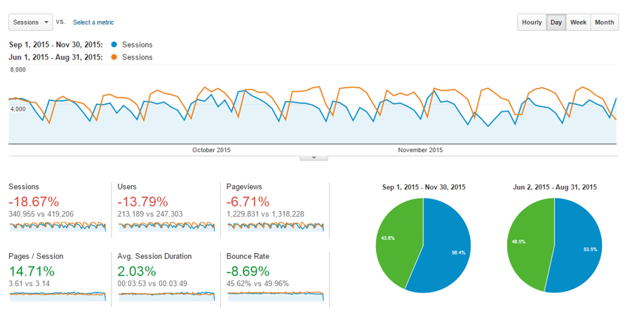
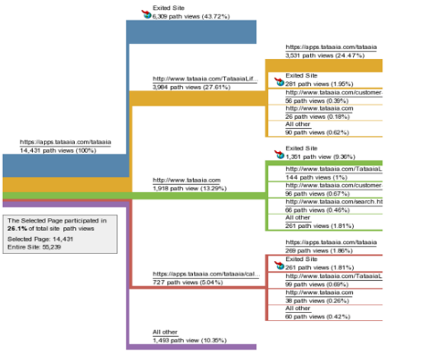
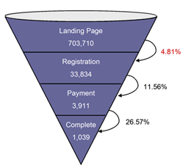
Website Diagnosis & Funnel Analysis
Key Website Metrics
Customer Journey
Website Conversion Funnels
Confidential Property of Tata Industries Ltd – Tata Insights & Quants Division

Slide 8
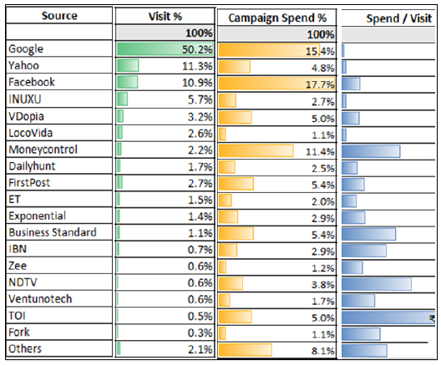
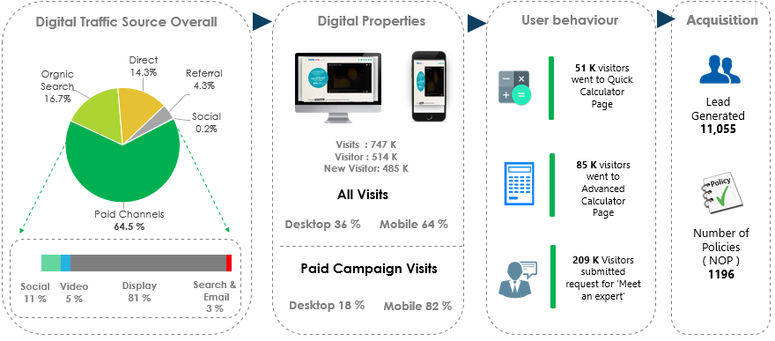
Digital Marketing Effectiveness
Channel Effectiveness
Campaign Effectiveness
Confidential Property of Tata Industries Ltd – Tata Insights & Quants Division

Slide 9
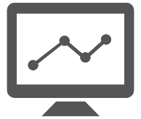



Digital Competitive Insights
Area | Output
Digital Benchmarking | Website Traffic Estimates – Desktop & Mobile Website Engagement – time on site , Bounce rate , page/visit Website Traffic trend and Insights
Traffic Source Insights | Analysis of digital marketing strategy of direct competitors by studying top website traffic sources : Referral Traffic – Top Referring website Paid Traffic – Top Ad networks Social – Top Social Channels
Keywords Analysis | Performance of Keywords among direct competitors in generating website traffic
Customer Journey | Top Website Sections and Pages on Competitor’s Website Estimate of Digital Business Performance and online customer journey on Competitor’s Website

Slide 10
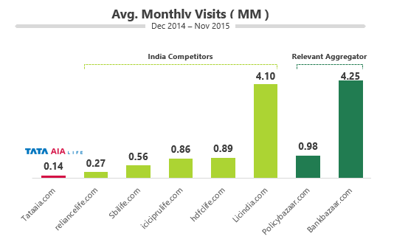
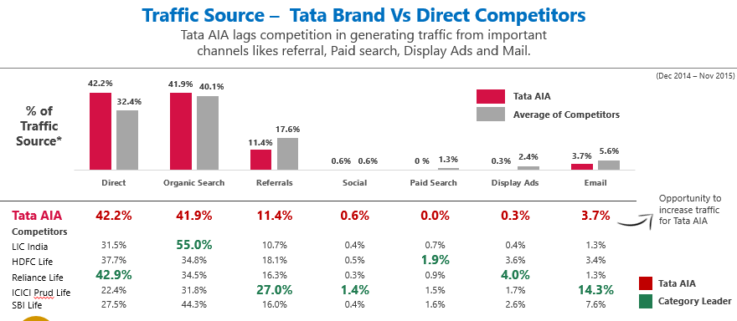
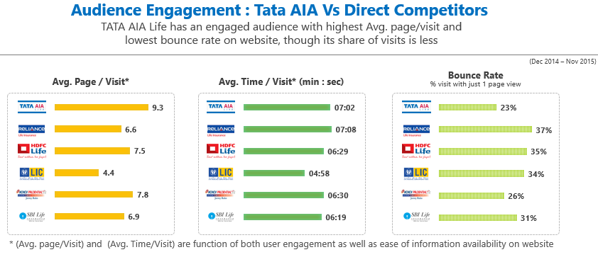
Digital Competitive Insights
Website Traffic
Traffic Source
Website Engagement
Confidential Property of Tata Industries Ltd – Tata Insights & Quants Division

Slide 11





Social Media Analytics
Area | Output
Social Reach & Engagement | Monthly performance of brand across all key Social Media KPI’s All KPI’s benchmarked to top industry players
Sentiment Analysis | Monthly Sentiment Analysis benchmarking across social media
Voice of Customer | Customer topic detection Customer sentiment across topics and social channels
Brand Topic | Performance of Brand posts on social media across industry
Social Campaign | Performance of Social media Campaigns of direct competitors

Slide 12
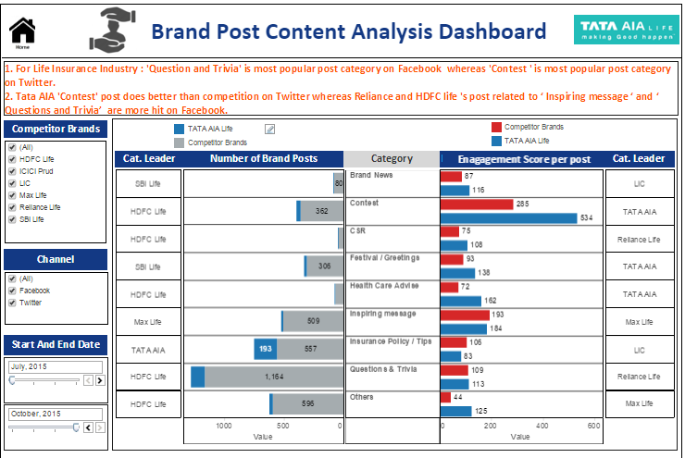
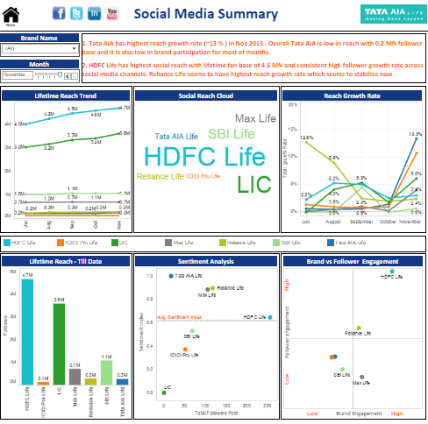
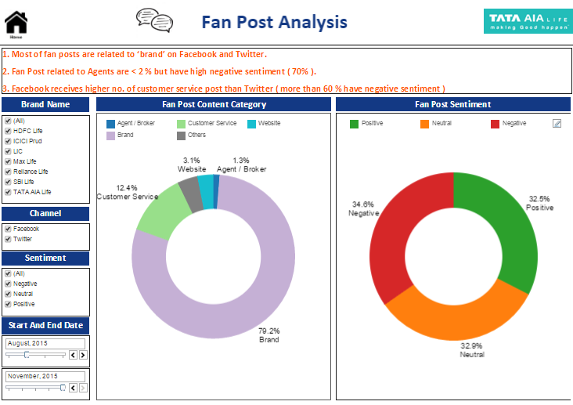
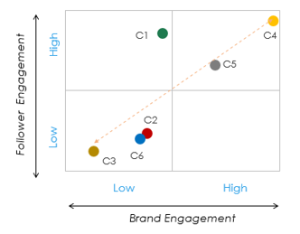
Social Media Analytics
Brand Content Analysis
Social Media Trend
Customer Topic Analysis
Social Benchmarking
Confidential Property of Tata Industries Ltd – Tata Insights & Quants Division

Slide 13


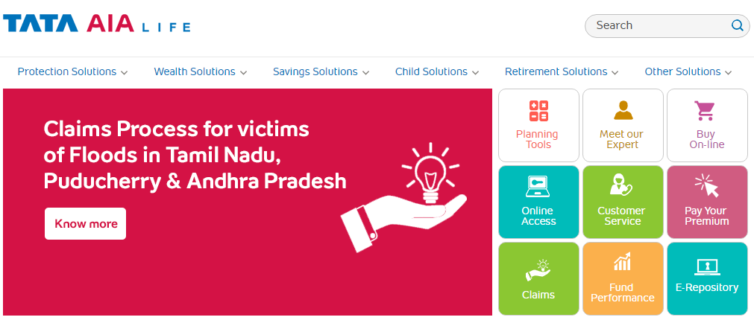
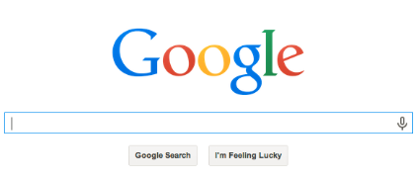








Digital Remarketing – As an Experiment
Remarketing relevant & engaged audience across digital channels results in higher conversion rate on website. This is primarily done by implementing tracking code of relevant ad –ecosystem on own website , Ex: Google Remarketing Tag
Process
Channel
Benefits
Search
Customer Retention
Engage with bounced site visitors
2. Visited Tata AIA website
Brand Awareness
1. Prospect
Social
Boost brand recall and stay on top of mind
Advertiser Website
Driving Sale
Display
Sell 1X1 focused ad to audience
Own Site
4. Watches Remarketing Banner
3. Prospect Interest tracked
CRM
Social Engagement
Increase social presence & conversion

Slide 14

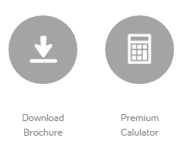
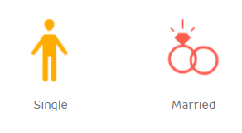
Why Remarketing
Few Application on Tata AIA Website :
Retarget users who abandoned the cart in between in last 1 month
Retarget users who downloaded brochure or used calculators on website in last 3 month
Retarget users on internet with personalized ads based on which product section they visited in past 3 month.
Either product based
Or Life stage Based
Industry Usage :
Mostly remarketing in India is currently used by Ecommerce firms ( such as Amazon , Flipkart etc. ) or Travel & Hospitality Industry ( such as Makemytrip, yatra etc.)
Avg. CTR for a retargeted ad is 10 times more than CTR of a display ad *
Retargeting can lead to a 147% higher conversion rate, when used in combination with prospecting *
Source : CMO.com , Digitalinformationworld.com, Comscore 2014-15

Slide 15

Thank You
Tata Industries Limited
Tata Insights & Quants Division
‘The Address’ | 5th Floor | Sy. No.17/1 | Outer Ring Road
Oppo. Prestige Cessna Park | Kadubeesanahalli| Bangalore 560 087

Slide 16
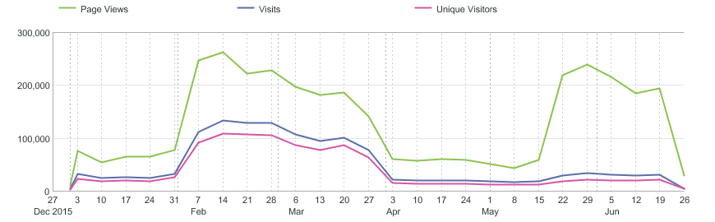
Digital Competitive Insights
‘Catchup’ Campaign
Customer Login page tagged
Confidential Property of Tata Industries Ltd – Tata Insights & Quants Division

Slide 17
Digital Competitive Insights
Website Traffic
Confidential Property of Tata Industries Ltd – Tata Insights & Quants Division

Slide 18
Digital Competitive Insights
Website Traffic
Confidential Property of Tata Industries Ltd – Tata Insights & Quants Division

Slide 19
Digital Competitive Insights
Website Traffic
Confidential Property of Tata Industries Ltd – Tata Insights & Quants Division

